Slide 1
Milestone 3
Team 3
Shashank Ramprasad
Sakshi Patil
Dhiraj Lahoti

Slide 2


Data preparation
Original distribution: Post balancing:

Slide 3
SVM
Linear SVM Model:
Performance Metrics for Each Class:
Class 0 (Non-Diabetic): Precision - 0.57, Recall - 0.66, Specificity - 0.76, Accuracy - 0.71
Class 1 (Pre-Diabetic): Precision - 0.41, Recall - 0.32, Specificity - 0.77, Accuracy - 0.55
Class 2 (Diabetic): Precision - 0.51, Recall - 0.54, Specificity - 0.73, Accuracy - 0.64
The linear classifier is decent at predicting non-diabetic and diabetic participants but struggles with accurately identifying pre-diabetic participants. Overall accuracy ~ 50%

Slide 4
RBF Kernel SVM Model:
Performance Metrics for Each Class:
Class 0 (Non-Diabetic): Precision - 0.63, Recall - 0.67, Specificity - 0.80, Accuracy - 0.74
Class 1 (Pre-Diabetic): Precision - 0.53, Recall - 0.39, Specificity - 0.83, Accuracy - 0.61
Class 2 (Diabetic): Precision - 0.57, Recall - 0.68, Specificity - 0.73, Accuracy - 0.70
The RBF kernel shows overall improved performance in accuracy, sensitivity, and specificity across all classes, particularly for the pre-diabetic class. Overall accuracy ~ 58%

Slide 5
Neural Networks
Neural Network Design and Experimentation:
The network was implemented in Python using the scikit library.
Various setups were experimented with, adjusting the number of hidden layers, neurons, and activation functions.
Experimented Configurations:
Logit Activation Function: A setup with two hidden layers consisting of 5 and 3 neurons.
ReLU Activation Function: A setup with three hidden layers having 6, 4, and 2 neurons.
Tanh Activation Function: A setup with three hidden layers with 6, 4, and 2 neurons.

Slide 6
Optimal Configuration:
The best results were obtained using the tanh activation function with a hidden neuron architecture of 5, 3, and 3.
This configuration achieved an accuracy of 47.93%.

Slide 7
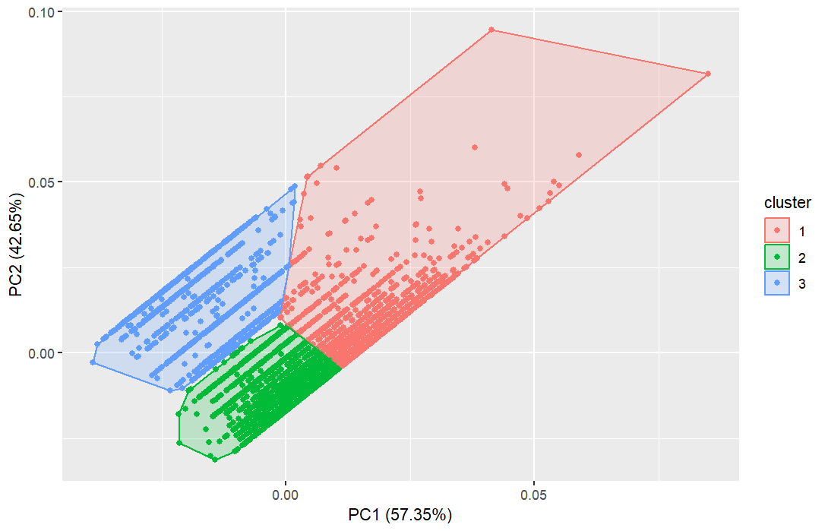
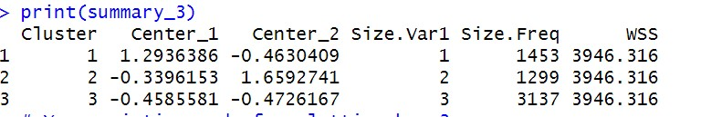
Clustering
K Means Clustering
Summary

Slide 8
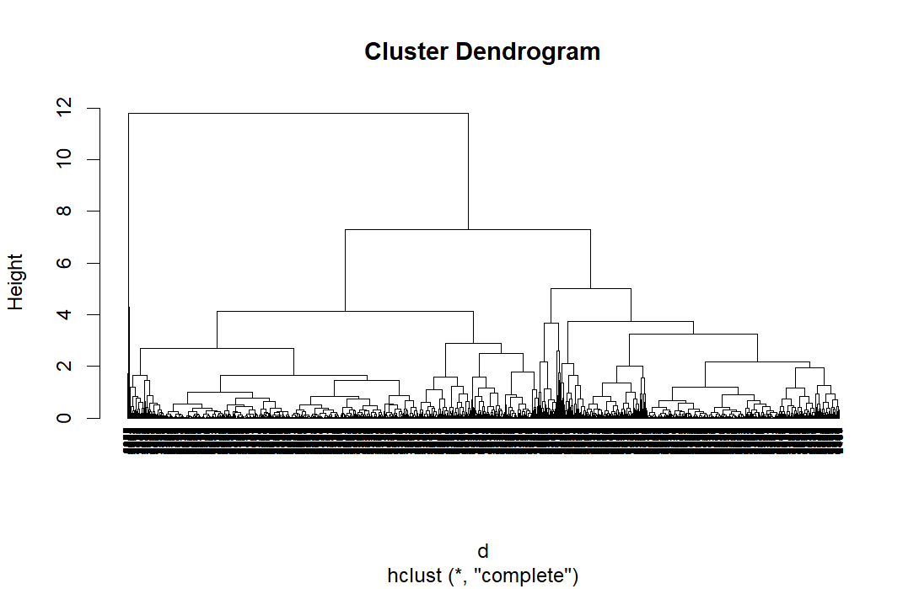
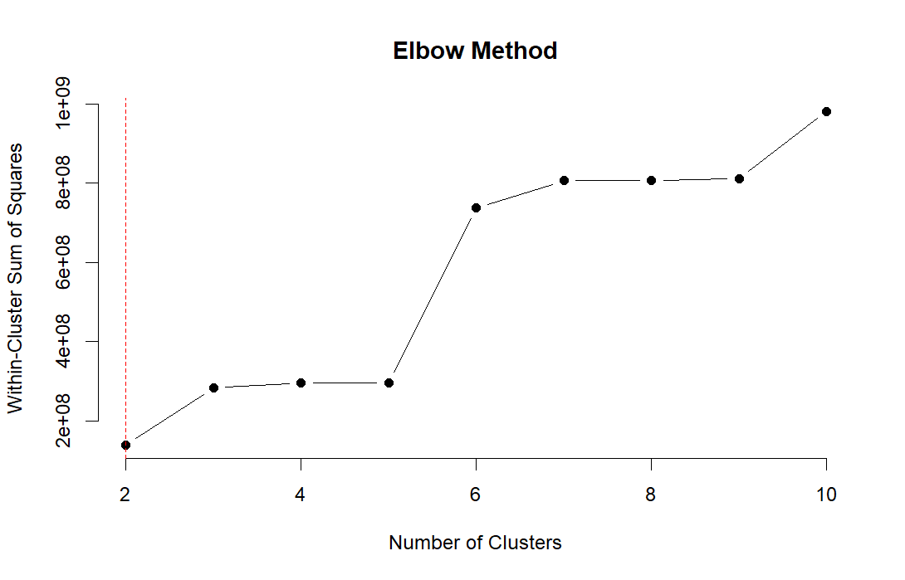

Hierarchical Clustering

Slide 9
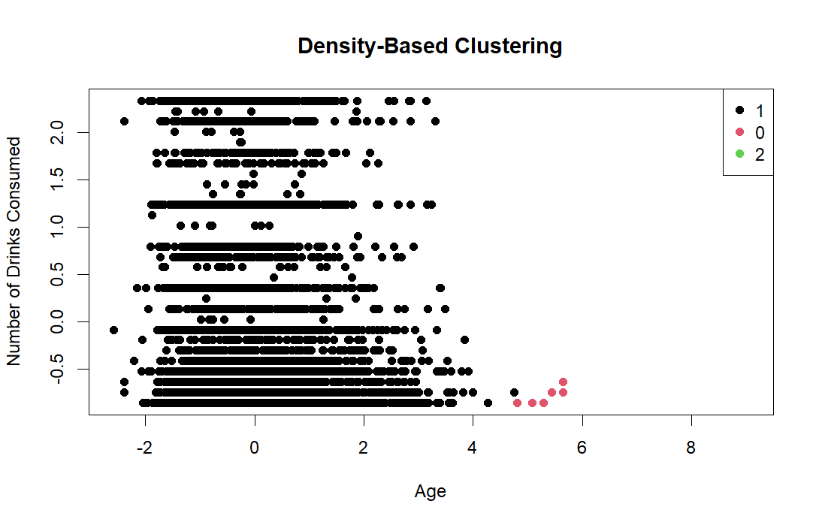

Density Based Clustering
minPts | 5
eps | 0.5

Slide 10
Comparative Analysis
Random Forest (RF) Model:
Accuracy ranges from approximately 0.469 to 0.51 with a mean around 0.495.
Similar accuracy values are observed in both k-fold and random subsampling cross-validation.
Support Vector Machine (SVM) Model:
Accuracy ranges from approximately 0.474 to 0.515 with a mean around 0.495.
Accuracy values for SVM are also similar across different validation methods.
Neural Network (NeuralNet) Model:
Accuracy ranges from approximately 0.428 to 0.467 with a mean around 0.448 in k-fold cross-validation.
There's a slight increase in mean accuracy scores (from 0.448 to 0.451) in random subsampling cross-validation.

Slide 11
Feature Selection
Feature Selection on Multinomial Logistic Regression (Filter Method):
Initial model: 15 features, expanded to 42 due to multicategorical variables.
Initial accuracy: 52.12%.
Selected top 5 significant features: BMI, Age, General Health, Income Category, Alcohol Consumed.
Modified model: 5 features, accuracy: 51.18%
Feature Selection on Decision Tree (Tree-based Embedding Method):
Original model: 15 features, accuracy: 47.37%.
Selected top 5 features: General Health, BMI, Age, Income Category, Alcohol Consumed.
New model: 5 features, accuracy: 47.11%.

Slide 12
Feature Selection in SVM (Wrapper Method Using Sequential Forward Selection):
Original SVM model accuracy: 51%.
After Sequential Feature Selector: Still 51% accuracy, with improved recall scores for Class 0 and Class 2.
Consistently predictive features: Age, BMI, General Health, Income Category.

Slide 13
Potential Ethical Issues
How was the data collected?
Centres for Disease Control and Prevention (CDC)
BRFSS conducts over 506,000 interviews
Structured questionnaire with core questions, optional modules, and state-added questions
How were the variables computed?
2022 BRFSS Survey Data
Inclusion of cellular telephone use for improved representativeness
Weighting methodology: 'Raking' or iterative proportional fitting
Inclusion of demographic variables to minimize selection bias

Slide 14
Permission Requested and Informed Consent
Likely adherence to ethical standards, although specific details not provided
Fairness in models
Dataset Representativeness:: BRFSS dataset may not fully represent diverse demographic groups.
Cultural and Lifestyle Differences: Model's accuracy may vary for individuals with different cultural backgrounds.
Lack of Hereditary and Family History Data: Genetic factors are missing from the model, impacting risk assessments.
Age and Racial Diversity: Age and racial categorization limitations affect model predictions.
Diabetes Classification: The model's diabetes classification oversimplifies complex risk factors.

Slide 15
THANK YOU

